Slide 1


Needles without the Thread
Threadless Process Injection

Slide 2
whoami
Ceri Coburn (@_EthicalChaos_)
Software developer for 18 years within the DRM and security solutions space
Joined the infosec game in August 2019
Dedicated to Red Teaming and offensive security tooling for the last 2 years
Author of several tools released to the community including BOF.NET, SweetPotato and SharpBlock
Member of the Rubeus maintainer team

Slide 3
What we will cover?
What is process injection and why do we leverage it
What methods are currently used
How is process injection detected
A quick primer on function hooking
Threadless process injection
Live demo
Detection results
Improvements
Q&A

Slide 4
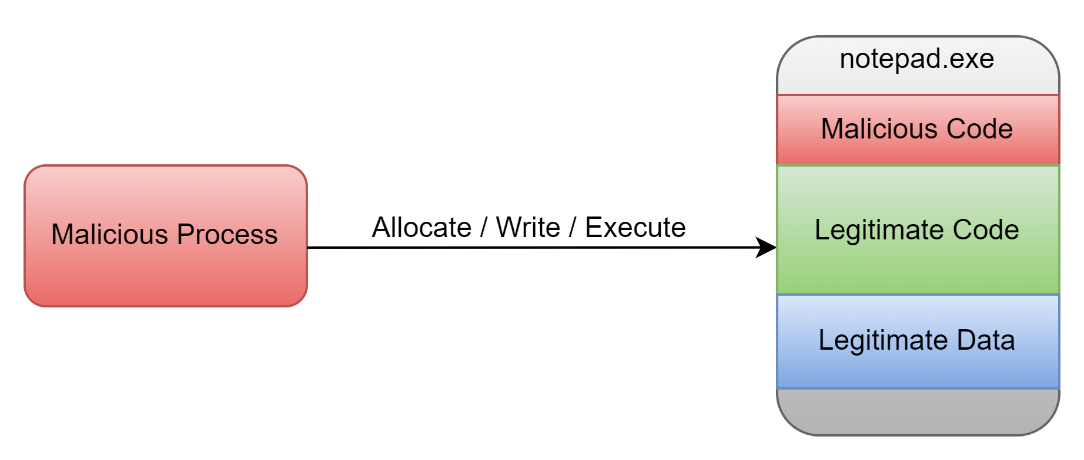
What is process injection?
The What
Execute code within the context of a foreign process.
The Whys – The three B’s
Break execution chains
Blend malicious activity among legitimate processes, e.g. browsers
Bypass security controls

Slide 5
The How
Typically broken down into 3 steps:
Executable memory allocation (Allocation Primitive)
Writing code to allocated memory (Write Primitive)
Executing the code (Execution Primitive)

Slide 6
Methods
Allocation Primitives
Write Primitives
VirtualAllocEx
NtMapViewOfSection
Code Caves
WriteProcessMemory
Direct copy after NtMapViewOfSection
Atom Bombing
Ghost Writing

Slide 7
Execution Primitives
CreateRemoteThread
NtQueueApcThread
Thread manipulation
SuspendThread
SetThreadContext
ResumeThread
Stack Bombing ROP chains
Callback Overwriting
Typically requires specific prerequisites
Each method typically involves a trigger from the injecting process
Check out SafeBreach’s talk from 2019
Process Injection Techniques - Gotta Catch Them All

Slide 8
Detection
Often detected by EDRs hooking key API’s but more vendors are moving to EtwTi
Alerting on any single primitive will often result in lots of false positives.
Detection is typically performed when a combination of all primitives have occurred in succession
Even then, false positives occur since legitimate process often use some of the primitives involved
What happens if we can remove the cross process execution primitive?

Slide 9
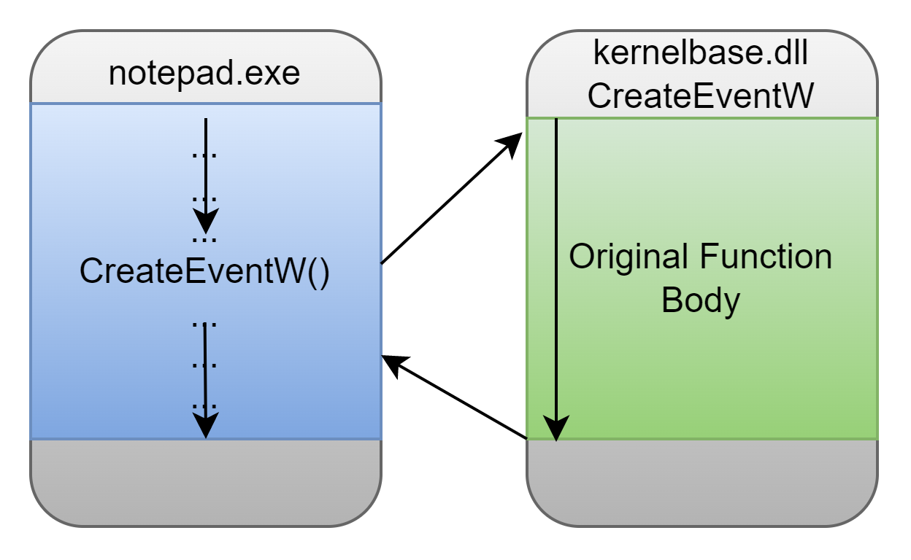
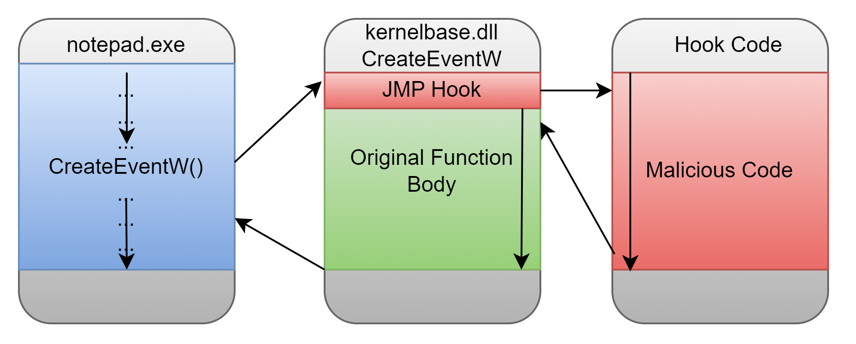
Function Hooking Primer
Function hooking is simply the redirection of execution flow that can replace or modify the behaviour of a certain function.
Unhooked Function Call
Hooked Function Call

Slide 10
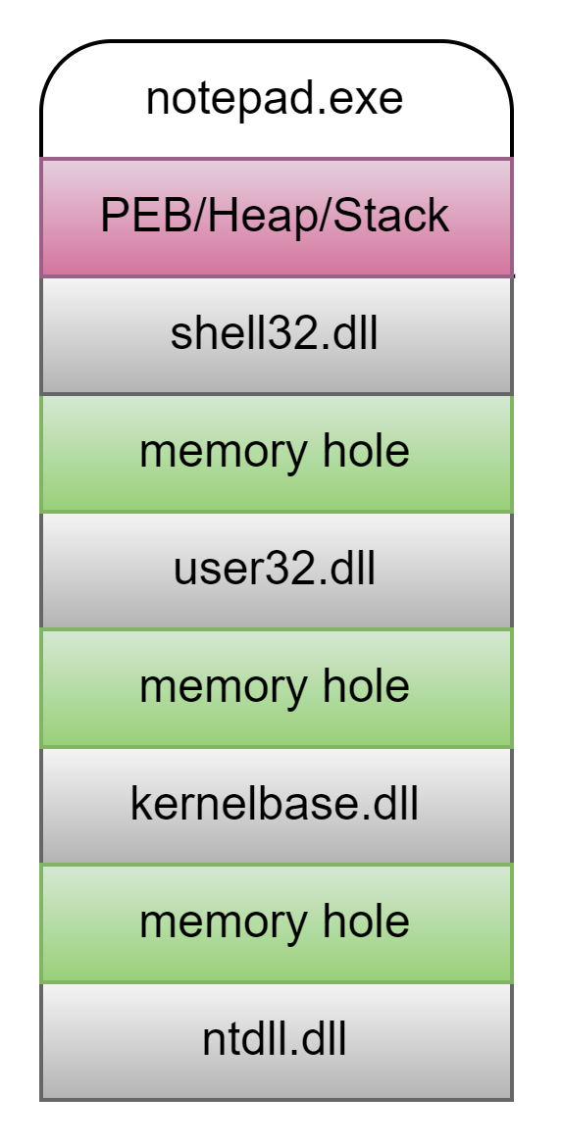
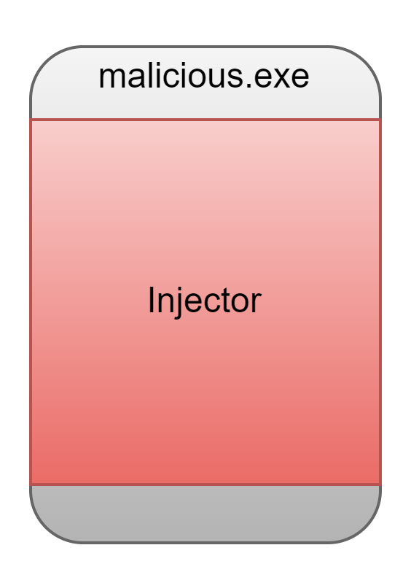
Threadless Process Injection
By combining cross process memory allocation and writing primitives, we can hook a loaded DLL export function and wait for legitimate process API calls to trigger our shellcode
Typical process memory layout
Allocate hook code + shellcode within memory hole of target DLL export
Patch exported function to CALL hook
Wait for legitimate process activity to call hooked API
Hook + shellcode

Slide 11
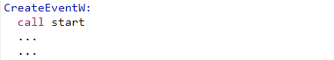
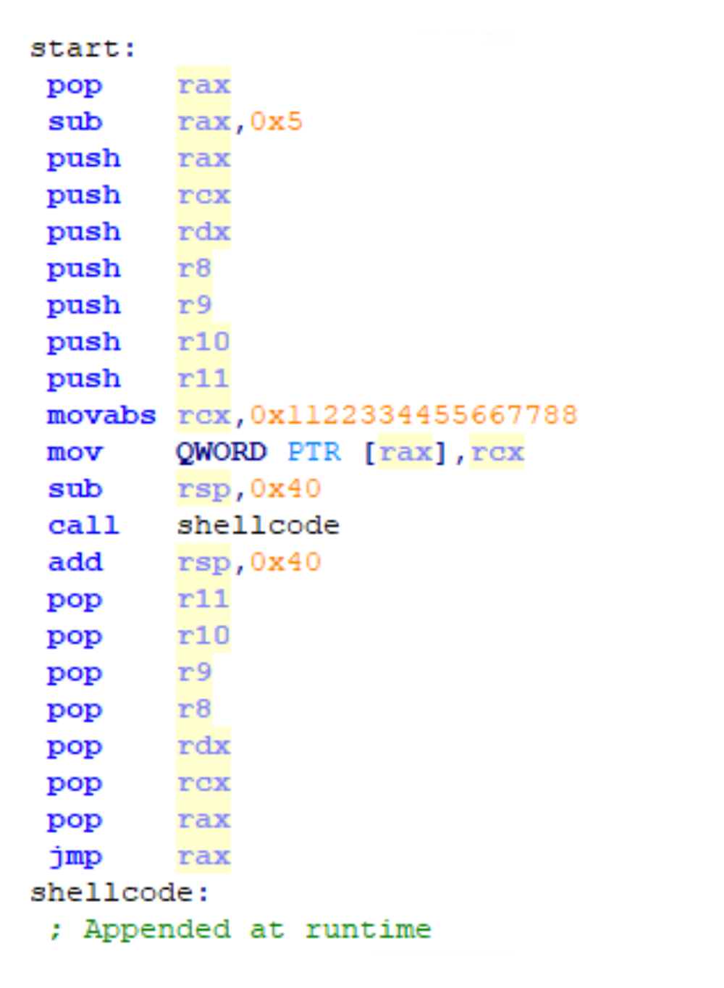
Hook Code
Hijack Execution Flow
1st instruction of hooked DLL export CALL’s our hook code
Save Hook Address
Return address is popped off the stack and subtracted by 5 to give us our original export address that was hooked
Save Arguments
We save the volatile registers onto the stack as these will need to be restored prior to calling the original function
We restore the original export function code so that the hook is no longer present
Restore
Call Shellcode
A relative function call is made to the injected shellcode (immediately following the hook code)
Restore Arguments
Once the injected shellcode is executed we restore all the volatile registers
Finally we restore the original export address and jmp, maintaining the intended behaviour of the injected program
Resume Original Call

Slide 12
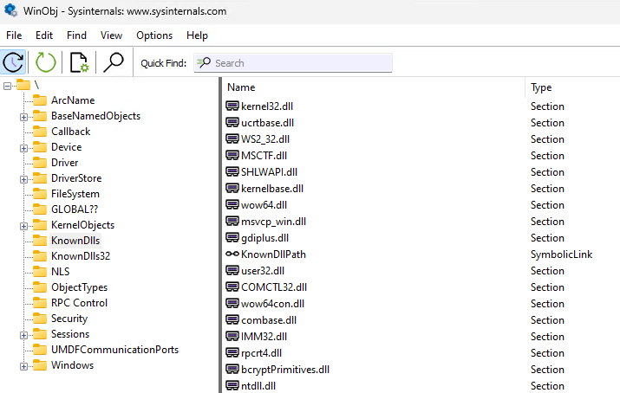
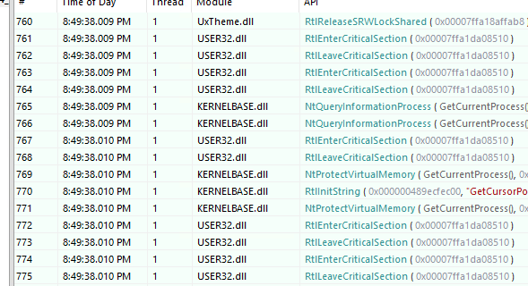
Which DLL/Export to Target?
Key DLL’s like ntdll or kernelbase have the same base address in all processes.
Use tools such as API Monitor to analyse your intended target process.
Avoid busy API calls like RtlAllocHeap, NtClose and RtlEnterCritical Section
Target API’s to trigger shellcode just before specific events, e.g. kernelbase!TerminateProcess or ws2_32!connect

Slide 13





DEMO TIME
ThreadLessInject
https://github.com/CCob/ThreadlessInject

Slide 14
Results
EDR Vendor | Blocked | Detected | Notes
MDE | No | No
CrowdStrike | No | No
Cybereason | No | No
CylanceOPTICS | - | Yes | Detects all cross process activity in aggressive mode, CylancePROTECT did not detect or block
SentinelOne | No | No
Symantec | No | No
Sysmon | - | No

Slide 15
Possible Improvements
Use more covert allocation and write primitives
Use patchless hooking via debugger attachment and hardware breakpoints (https://www.pentestpartners.com/security-blog/patchless-amsi-bypass-using-sharpblock/)
Avoid RWX on hooked function. Hook assembly will need to handle VirtualProtect calls
Support any DLL via remote module enumeration

Slide 16
Q&A

Slide 17


Thanks
for
listening
@_EthicalChaos_
CCob
ethicalchaos.dev

